Slide 1
News data
Navon Francis

Slide 2
The Question
How do we portray news?

Slide 3
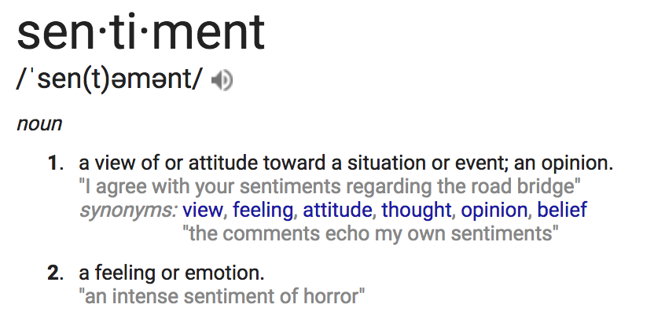

The Data – Summary
Newly created dataset, scraped from euronews.com and npr.org
110 articles chosen i.i.d. from both websites for 2017
Articles then processed through Google’s Natural Language API
Performed sentiment analysis for each article
Sentiment values range from -1 to 1, negative to positive emotion

Slide 4
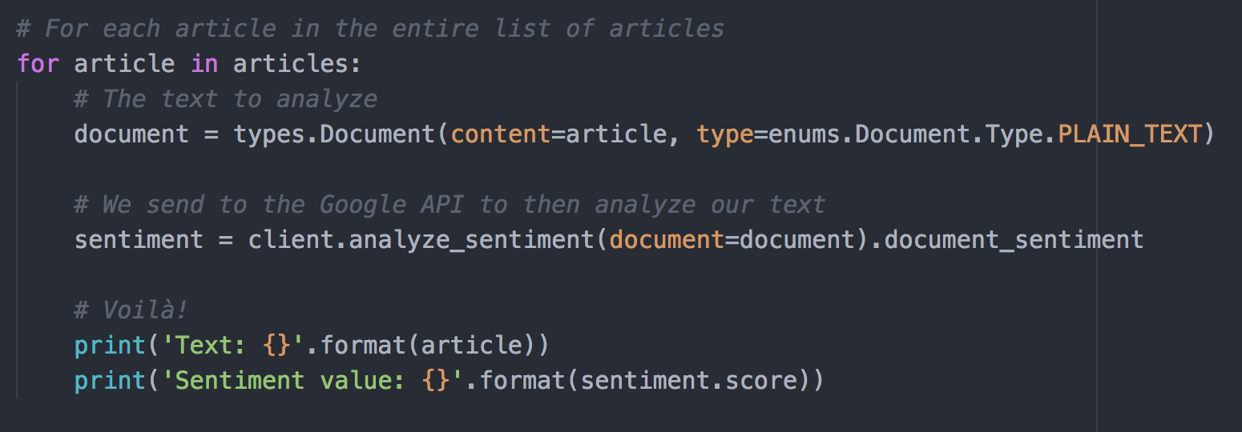
The Data – API
Google make’s this really easy!
This is the Natural Language API at work

Slide 5

The Data – Results
A portion of the dataset, US news

Slide 6
The Model – Choices
What is the best model to use for this data?
We obviously can not look at every article ever written
We have two sample sets of values
Maybe a t test, but which one..?
One sample t test?
Independent samples t test?
Paired samples t test?

Slide 7
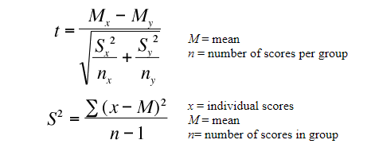
The Model – Verdict
The Independent Samples t test
We will test the difference between the two sample means
Our dependent variable is from -1 to 1, our interval
Our dependent variable is from the sample population
We need mean M, variance S², and sample size n of (1) SVs – for t
Abbreviation:
1. SV: Sentiment value.

Slide 8
The Analysis – Summary
Using the Independent samples t test
Analyze both means of sample sets (US and Euro)
Two independent groups to be compare
Data parameters: 110 (1) SVs US articles & 110 SVs of Euro articles
We will compare calculated t value to the critical t value
Abbreviation:
1. SV: Sentiment value.

Slide 9
The Analysis – Computation
At this point, we should think about the question again
We will apply the independent samples t test to the dataset
“The mean emotion derived from EU news is equal to US news”
Null Hypothesis ---> H₀ : μ_{euro} = μ_{usa}
“The mean emotion derived from EU news is not equal to US news”
Alt. Hypothesis ---> H_{a} : μ_{euro} ≠ μ_{usa}

Slide 10
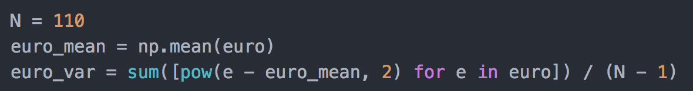
The Analysis – Computation
Find the variance:

Slide 11
The Analysis – Computation
Calculate t statistic:
Double check with scipy’s independent t test function

Slide 12
The Results – Summary
t statistic = 2.158
α = 0.05
df = 218
p val = 0.032
Critical t val = 1.984
Critical t (1.984) < calculated t (2.158)
p val (0.032) < α (0.05)
Recall H₀ : μ_{euro} = μ_{usa}
The critical t value is less than the calculated t statistic, reject H₀!
There is a statistical significance between the two population means

Slide 13
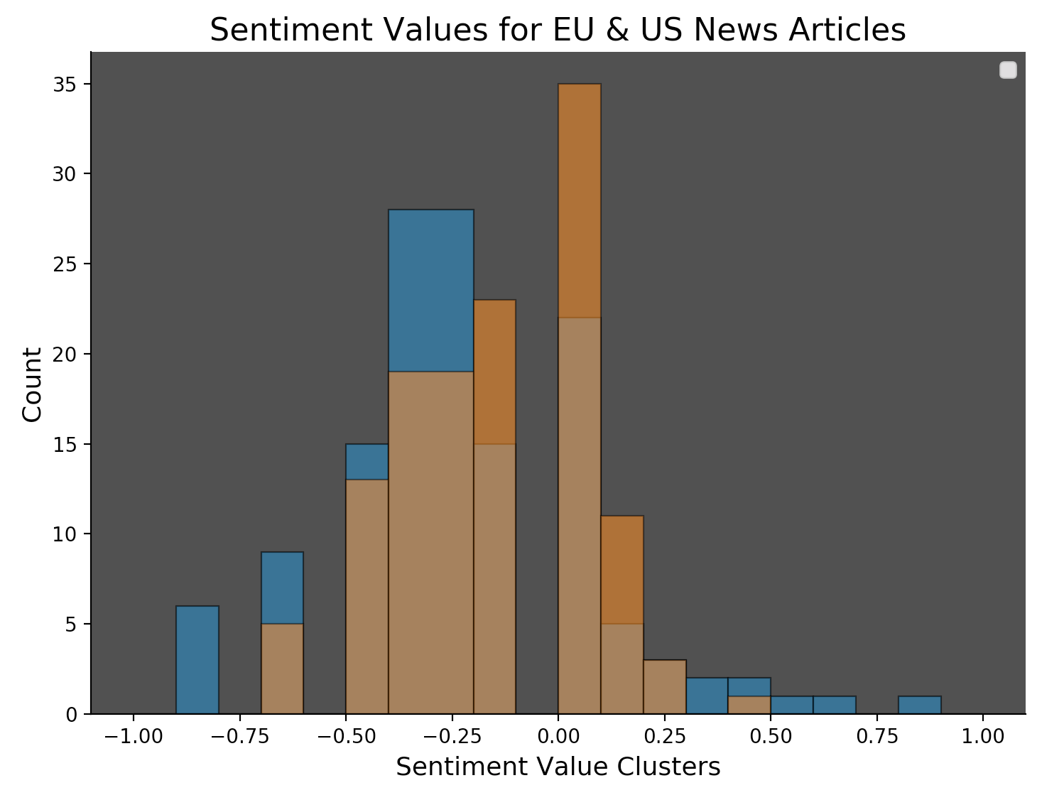
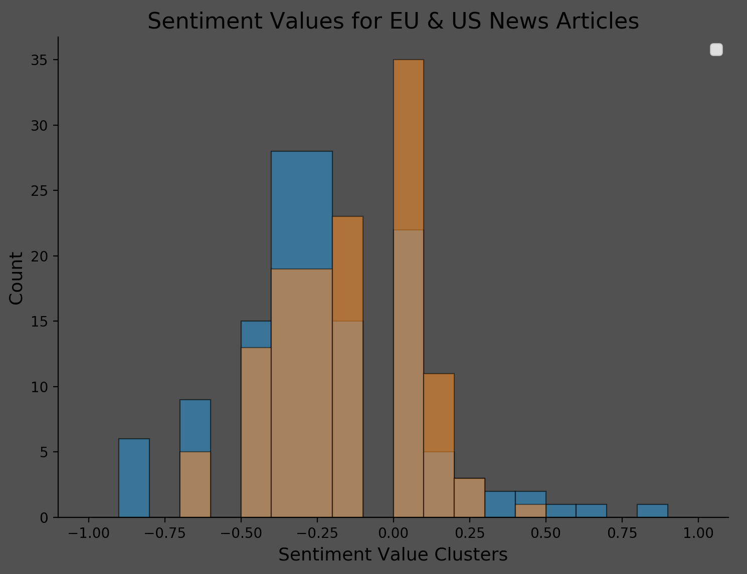
The Results – Histogram
EU - blue
US - orange
Shared - brown

Slide 14
The Conclusion
How do we portray news?
In summation, there is a difference between the two samples
Important because it provides some insight on how we portray things
US articles seem to have more 0’s, which means more mixed emotion
EU articles have more negative sentiment, can be more serious
This could lead to more discoveries in biased news
Further analysis to identify factual news based on this can be made

Slide 15
Thank you

